Slide 1
Seegene M Segmentation
20210224 강현정

Slide 2
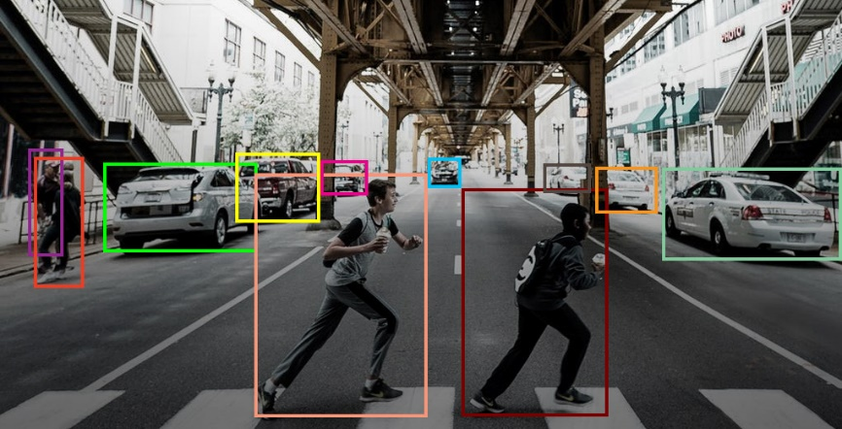
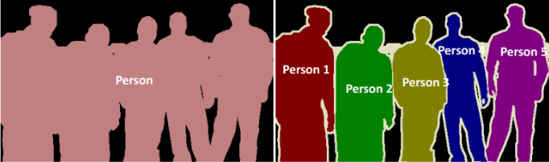
Object Detection & Semantic Segmentation
Object Detection
Semantic Segmentation
Instance Segmentation
Notes:
ca16a5ad-b106-4e84-8a43-178710e854ba.png

Slide 3
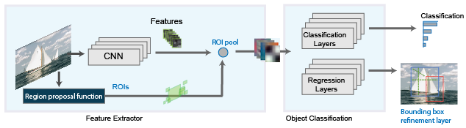
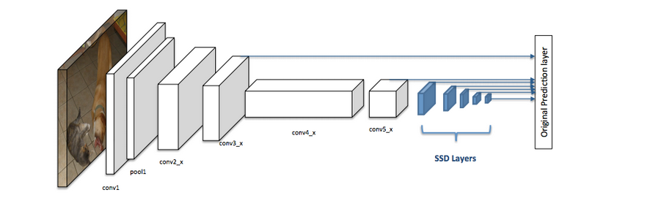
Object Detection
Two-stage detector
One-stage detector
Notes:
ca16a5ad-b106-4e84-8a43-178710e854ba.png

Slide 4
Object Detection
 | Model | mAP
Faster R-CNN | Two-stage detector Accurate but slow | 5.41%
YOLO | One-stage detector Fast model Recently, boosted accuracy | 1.01%
SSD | One-stage detector SOTA detector Mostly used in mobile networks | -
EfficientDet | One-stage detector 2020 SOTA detector Based EfficientNet (2020 SOTA object classification model) model | 0%
Notes:
ca16a5ad-b106-4e84-8a43-178710e854ba.png

Slide 5
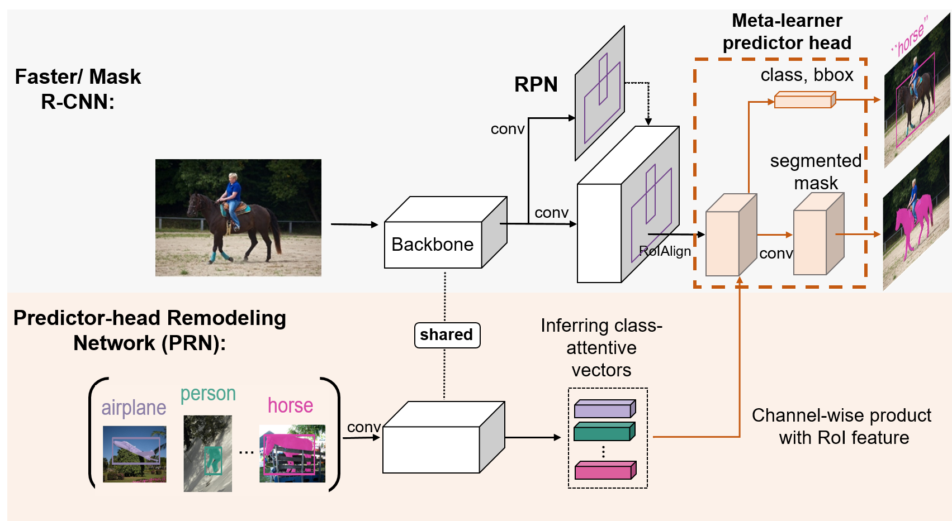
Semantic Segmentation – Two-stage detector
Added branch
Notes:
ca16a5ad-b106-4e84-8a43-178710e854ba.png

Slide 6
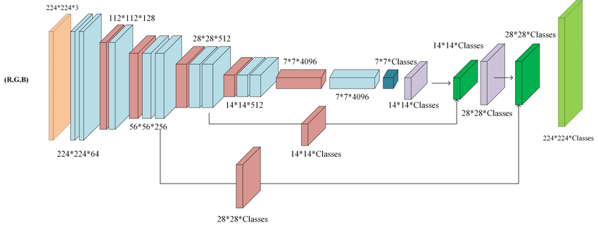
Semantic Segmentation – One-stage detector (Encoder-Decoder Model)
How to protect information loss?
How to get detailed boundary?
Encoder
Decoder
Notes:
ca16a5ad-b106-4e84-8a43-178710e854ba.png

Slide 7
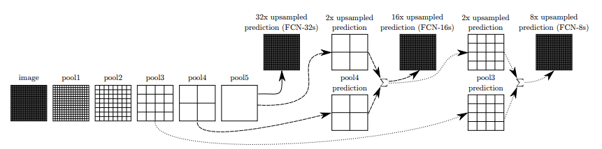
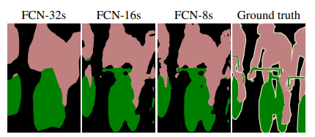
Semantic Segmentation – One-stage detector (Encoder-Decoder Model)
Fully Convolutional Networks for Semantic Segmentation
Notes:
ca16a5ad-b106-4e84-8a43-178710e854ba.png

Slide 8
Object Detection & Semantic Segmentation
 | Object Detection | Semantic Segmentation
training/test time | short good for mobile | long good for autonomous driving
cost | bounding boxes longer than recognition | pixel segmentation longer than detection
recent study | concentrated on one-stage networks (fast but inaccurate) boost performance of one-stage models | concentrated on encoder-decoder networks (accurate but slow) detailed boundaries shorten test time
application | models for mobile real-time detection models | autonomous driving pedestrian detection medical detection
Notes:
ca16a5ad-b106-4e84-8a43-178710e854ba.png

Slide 9
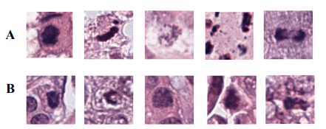
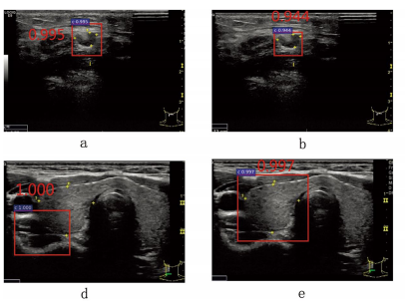
Object Detection & Semantic Segmentation in medical field
A : Mitosis (체세포분열)
B : Non-mitosis
Task : Mitotic nuclei (유사분열기핵)detection in breast cancer
histopathological images
Method : Mask R-CNN (Segmentation, Two-stage)
Task : Thyroid papillary cancer (갑상생유두암) in ultrasound images
Method : Faster R-CNN(Detection, Two-stage)
Sohail, A., Mukhtar, M. A., Khan, A., Zafar, M. M., Zameer, A., & Khan, S. (2020). Deep Object Detection based Mitosis Analysis in Breast Cancer Histopathological Images. arXiv preprint arXiv:2003.08803.
Li, H., Weng, J., Shi, Y., Gu, W., Mao, Y., Wang, Y., ... & Zhang, J. (2018). An improved deep learning approach for detection of thyroid papillary cancer in ultrasound images. Scientific reports, 8(1), 1-12.
Notes:
ca16a5ad-b106-4e84-8a43-178710e854ba.png

Slide 10
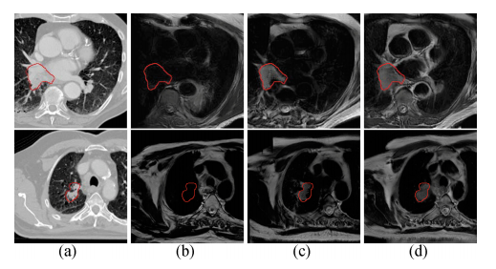
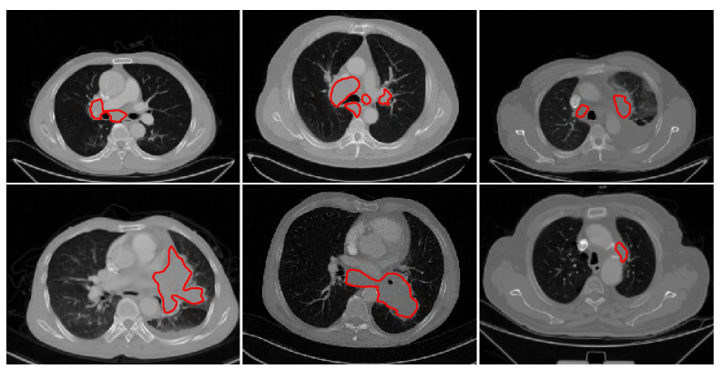
Object Detection & Semantic Segmentation in medical field
A : Ground-truth
B,C,D : Detection results
Task : Lung cancer segmentation in MRI images
Method : CycleGAN (Segmentation, One-stage)
Task : Lung cancer segmentation in MRI images
Method : 3D CNN Network (Segmentation, One-stage)
Jiang, J., Hu, Y. C., Tyagi, N., Zhang, P., Rimner, A., Mageras, G. S., ... & Veeraraghavan, H. (2018, September). Tumor-aware, adversarial domain adaptation from ct to mri for lung cancer segmentation. In International Conference on Medical Image Computing and Computer-Assisted Intervention (pp. 777-785). Springer, Cham.
Chen, W., Wei, H., Peng, S., Sun, J., Qiao, X., & Liu, B. (2019). HSN: hybrid segmentation network for small cell lung cancer segmentation. IEEE Access, 7, 75591-75603.
Notes:
ca16a5ad-b106-4e84-8a43-178710e854ba.png

Slide 11
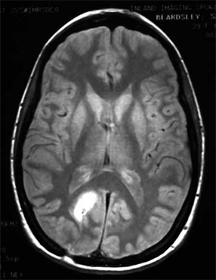
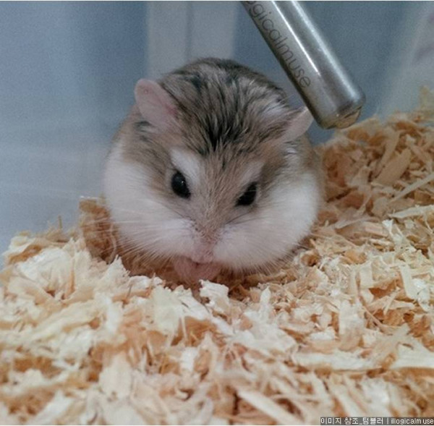
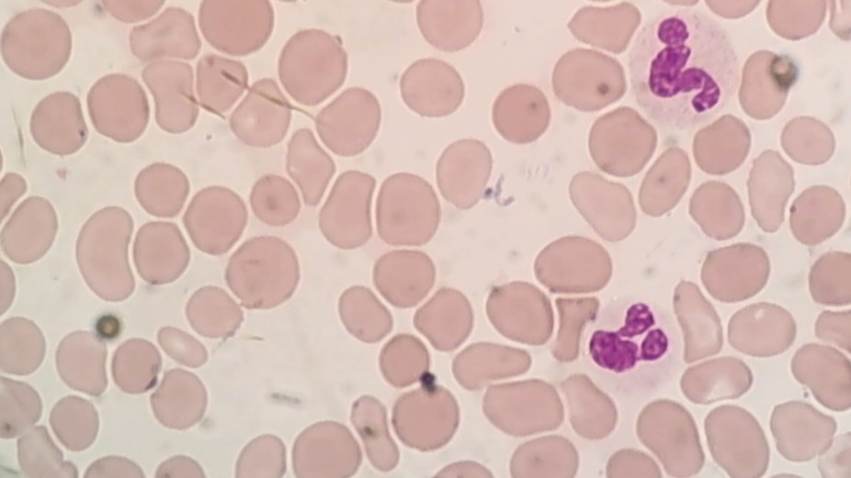

What is appropriate one in our case?
Medical Images – One object in one image
General Objects
Medical Images – Distinct boundaries
Correct Annotation!
It is hamster!
Hamster’s body? head?
What is that?
Notes:
ca16a5ad-b106-4e84-8a43-178710e854ba.png

Slide 12
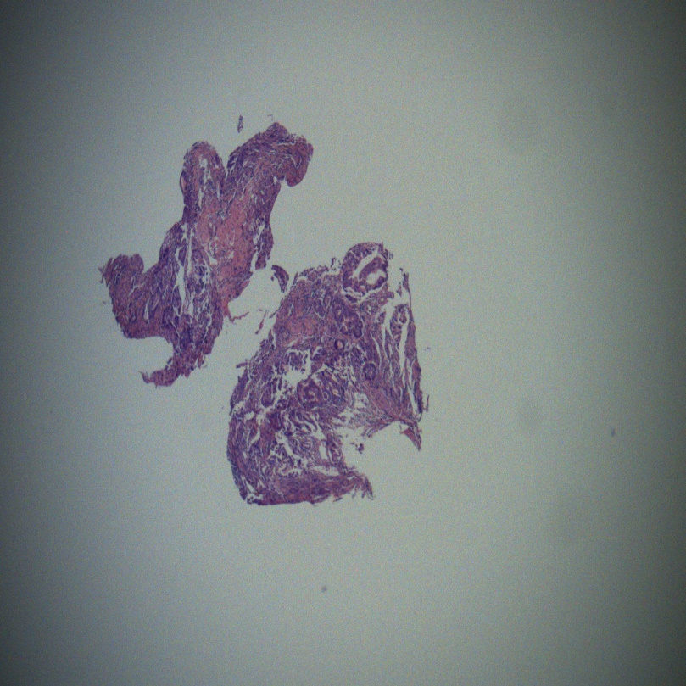
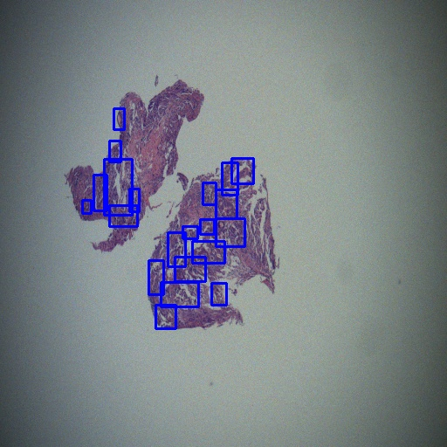
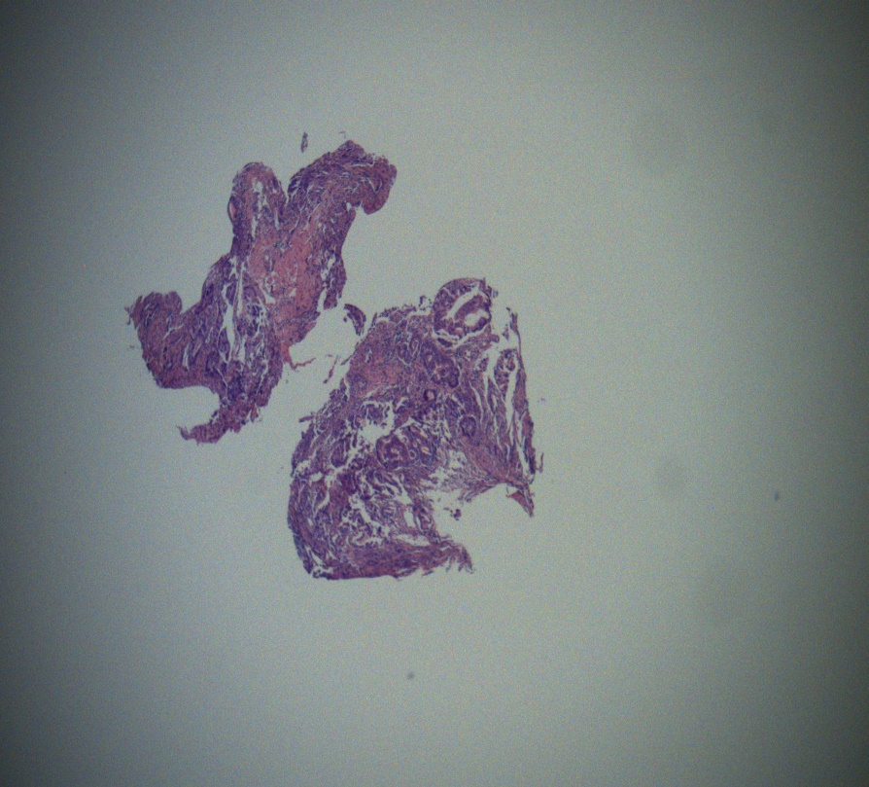
What is appropriate one in our case?
2020S 0151714010101-74
Image
Ground-Truth
Another Version
Notes:
ca16a5ad-b106-4e84-8a43-178710e854ba.png

Slide 13
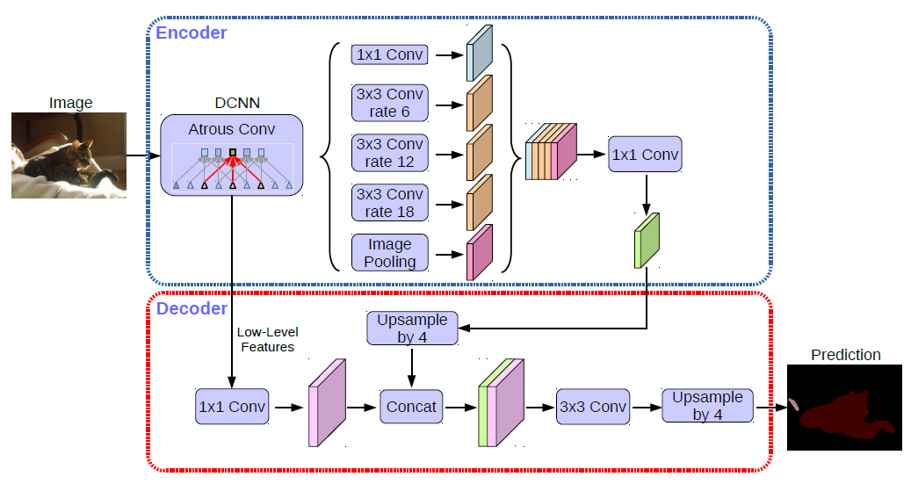
DeepLab v3
Notes:
ca16a5ad-b106-4e84-8a43-178710e854ba.png

Slide 14
DeepLab v3
DeepLabv3 - ResNet101
Dataset : 20201028_anchor
Model : DeepLabv3 + ResNet101
Data Augmentation : Resize (512) + Flip + Rotate
Batch Size : 1
Learning Rate : 0.0001
Model | Confidence Score | Accuracy
frcnn_anchor(1028) | 0.5 | 78.36%
frcnn_resnet_cbam | 0.5 | 80.36%
deeplabv3 | 0.5 | 67.47%
Notes:
ca16a5ad-b106-4e84-8a43-178710e854ba.png

Slide 15
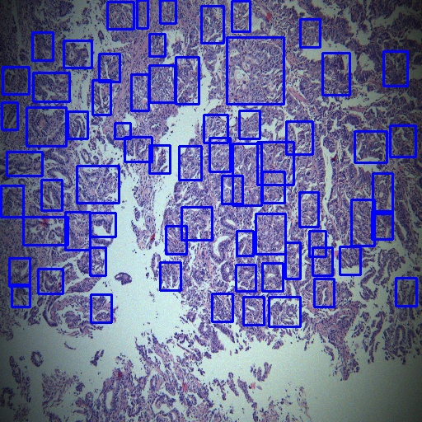
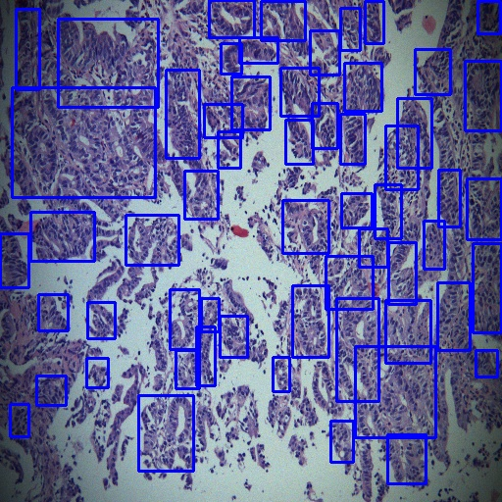
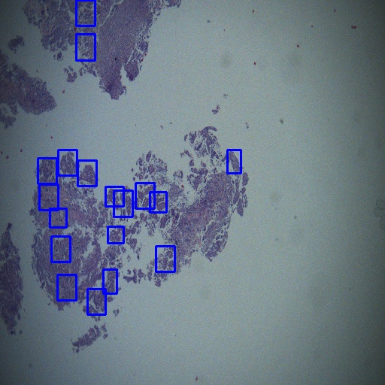
DeepLab v3
2020S 0002218010101-174
2020S 0002218010101-251
2020S 0002218010101-89
Notes:
ca16a5ad-b106-4e84-8a43-178710e854ba.png

Slide 16
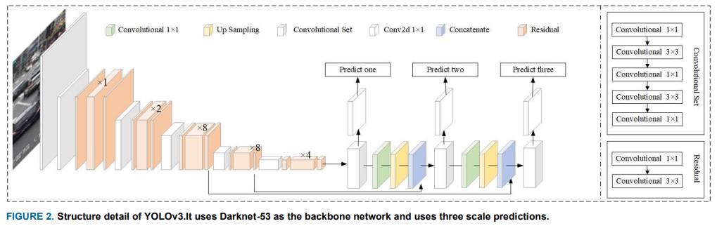
DeepLab v3
Notes:
ca16a5ad-b106-4e84-8a43-178710e854ba.png

Slide 17
Thank you :-)

